Slide 1
Finding the midpoint
Miss L
Year 9

Slide 2
Learning Intentions
Students will be able to
Find the midpoint of a line

Slide 3
Think about it…..
When I mention the midpoint, what do you think I mean?
Midpoint means halfway

Slide 4
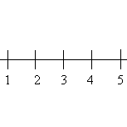
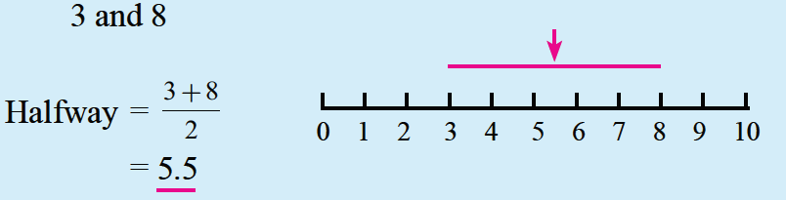
24
7
30
Topic: Midpoint of a Line
Date:
EQ – How do you find the midpoint?
What is the midpoint?
It is the halfway mark on a line
Which number is the midpoint between
the two dots?
What about if it’s a bit harder?

Slide 5
Practice
Notes:
Guide students through the question.
Option 2: Dot plots handout (Scaffolded for kids who may need extra help)

Slide 6


Slide 7
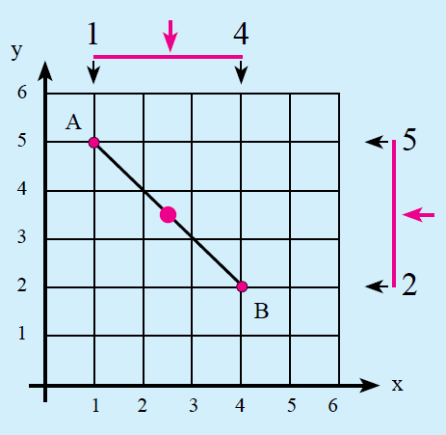
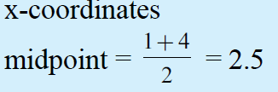
24
7
30
Topic: Midpoint of a Line
Date:
EQ – How do you find the midpoint?
Finding the midpoint of coordinates
Find the midpoint between A(1,5) and B(4,2)
Step 1: Find the midpoint for the x – coordinates

Slide 8
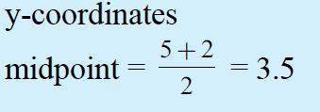
24
7
30
Topic: Midpoint of a Line
Date:
EQ – How do you find the midpoint?
Finding the midpoint of coordinates
Find the midpoint between A(1,5) and B(4,2)
Step 2: Find the midpoint for the y – coordinates

Slide 9

24
7
30
Topic: Midpoint of a Line
Date:
EQ – How do you find the midpoint?
Finding the midpoint of coordinates
Find the midpoint between A(1,5) and B(4,2)
Step 3: Put the answers in coordinate form

Slide 10
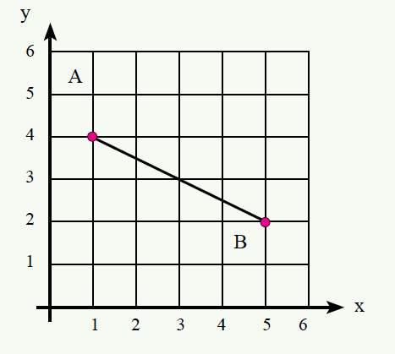
Practice
Step 1: Find the midpoint for the x – coordinates
Step 2: Find the midpoint for the y – coordinates
Step 3: Put the answers in coordinate form
Notes:
Guide students through the question.
Option 2: Dot plots handout (Scaffolded for kids who may need extra help)

Slide 11
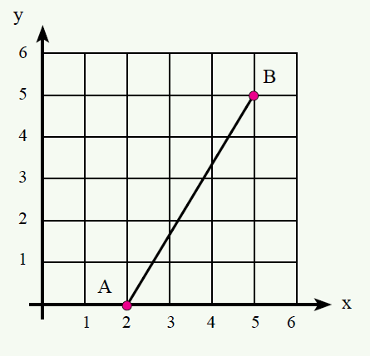
Practice
Step 1: Find the midpoint for the x – coordinates
Step 2: Find the midpoint for the y – coordinates
Step 3: Put the answers in coordinate form
Notes:
Guide students through the question.
Option 2: Dot plots handout (Scaffolded for kids who may need extra help)

